Slide 1

Going back over Skeleton & Forms

Slide 2
CA so far….
You now have 50% of your overall CA
  30% blog
  20% quiz
From now on, labs will be used for assignment work

Slide 3
Before we start forms, let’s look at last week’s lab exercise:
Use Skeleton on the Bistro website

Slide 4
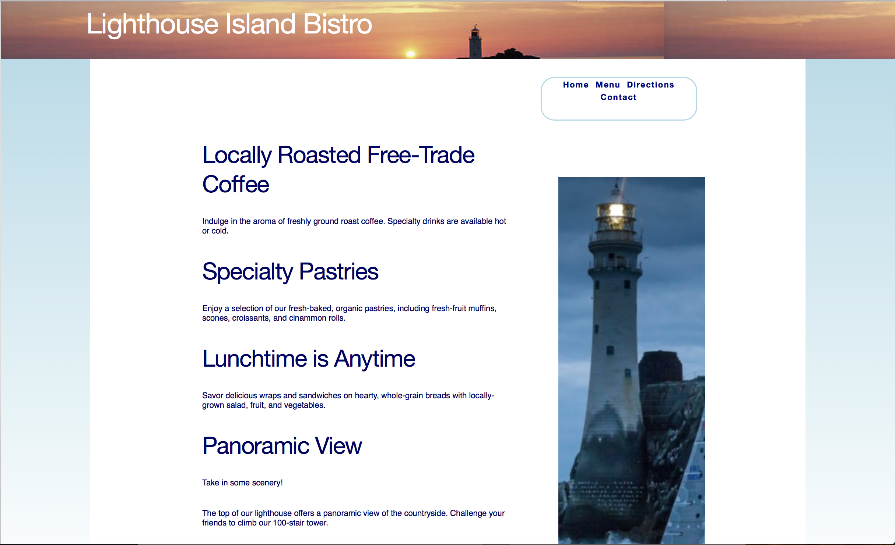
Bistro, using Skeleton
Use Skeleton on the Bistro website

Slide 5
We will use Skeleton for this part of the page
Use Skeleton on the Bistro website

Slide 6
We will use Skeleton for this part of the page
Use Skeleton on the Bistro website

Slide 7
Our Skeleton template looks like this:

Slide 8
The container (or outside rectangle) is as follows:
<div class=“container”>
</div>

Slide 9
There are 2 rows so the code is as follows:
<div class=“container”>
<!—Row 1-->
<div class=“row”>
</div><!—row-->
<!—Row 2→
<div class=“row”>
</div><!—row-->
</div>

Slide 10
The 2nd row has 2 columns – the 1st one is 2/3 of the width, the 2nd one is 1/3 of the width
<div class=“container”>
<!—Row 1-->
<div class=“row”>
</div><!—row→
<!—Row 2→
<div class=“row”>
<div class=“two-thirds column”>
</div><!—two-thirds-->
<div class=“one-third column”>
</div><!—one-third-->
</div><!—row-->
</div>

Slide 11
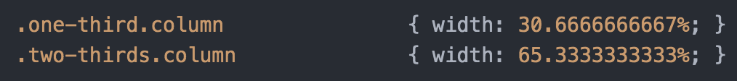
How did I know to put in two-thirds and one-third … Look in Skeleton .css

Slide 12
Now we need to structure this around the code we have for Bistro..
<div class=“container”>
<!—Row 1-->
<div class=“row”>
</div><!—row→
<!—Row 2→
<div class=“row”>
<div class=“two-thirds column”>
</div><!—two-thirds-->
<div class=“one-third column”>
</div><!—one-third-->
</div><!—row-->
</div>

Slide 13
Forms

Slide 14
Where are forms used?
In search engines
Placing an order
Joining an online mailing list
……..

Slide 15
Structure & Communication
The <form> tag with action attribute develops the link between the front and the back ends:
  action: indicates where to send the form information when the form is submitted
  method(get or post): indicates how the form will be sent
  id: used with CSS
  name: used for JavaScript
  autocomplete: to fill out forms (HTML5)

Slide 16
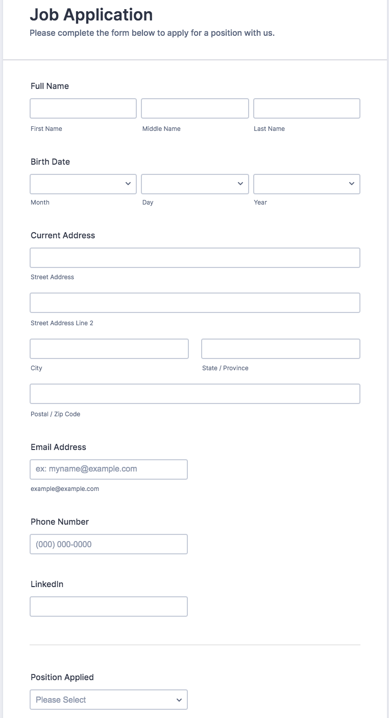

Slide 17
Elements
The main form elements are:
text fields – allows you to input a line of text
  Parameters: size and maximum length
radio buttons – provide multiple choices with only one selection
  Parameters: checked or unchecked
check boxes – provide multiple choices with multiple selections
  Parameters: checked or unchecked
menus – Provides a menu of verbose choices
  Parameter: size
text areas – Provide multiple lines of text
  Parameters: width and height
submit buttons – collects and sends form input
  Parameters: button label
reset buttons – erases or clears the form input
  Parameters : button label

Slide 18
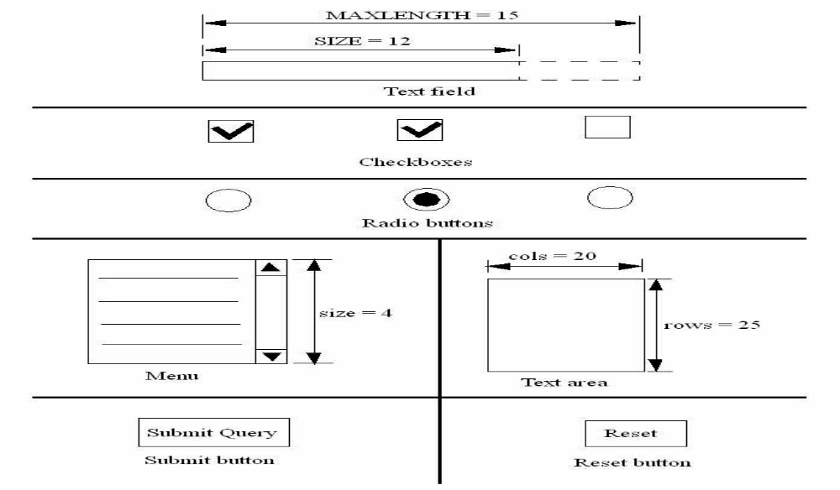
Elements

Slide 19
Over to you..
Could you sketch a contact form for Fish Creek Website?
Could you download “Starting point to put in form- Fish Creek.zip” from Brightspace and open up contact.html in your text editor?

Slide 20
Using Forms
There are 4 tags that can be used (+<form>)
  <input> - creates form elements
    Attributes : type, name, id, value, size, maxlength, checked,
  <select> - creates a menu
    Attributes : name, size, multiple
  <option> - creates menu items
    Attributes : selected, value, label
  <textarea> - creates a text area
    Attributes: name, rows, cols, wrap

Slide 21

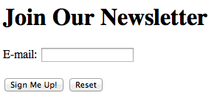
Text Field (Text Box)

Slide 22
Submit Button/Reset Button

Slide 23
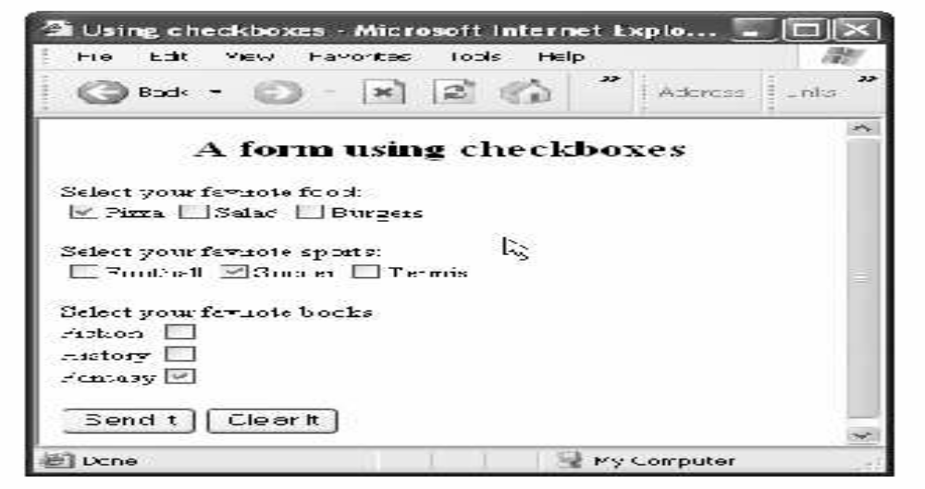
Checkboxes
<form name=“MyForm2” action="mailto:andrea.f.curley@.dit.ie" method="post">
<input type="checkbox" name=“FavouriteFood" value="Pizza" checked/> Pizza
<input type="checkbox" name=" FavouriteFood" value="Salad" /> Salad
<input type="checkbox" name=" FavouriteFood " value="Burger" /> Burger
<br/>
…
<input type="submit" value="Send It" />
<input type=“reset" value="Reset It" />
</form>

Slide 24
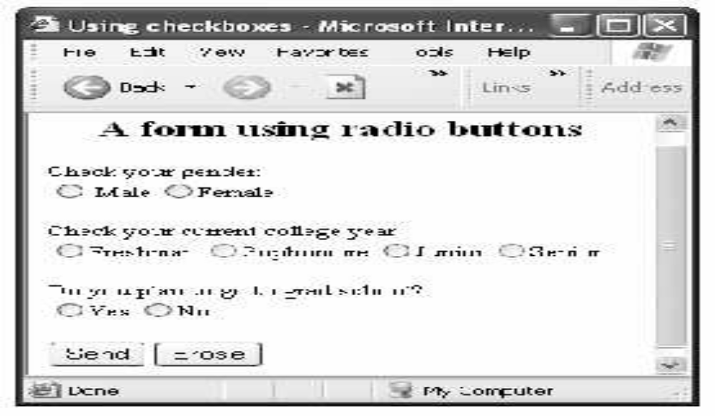
Radio Buttons
<form name="MyForm" action="mailto:andrea.f.curley@dit.ie" method="post">
<div>Check your gender:</div>
<input type="radio" name="gender" value="Male" /> Male<br />
<input type="radio" name="gender" value=”Female" /> Female<br />
<input type="submit" value="Send It" />
<input type=“reset" value="Reset It" />
</form>

Slide 25
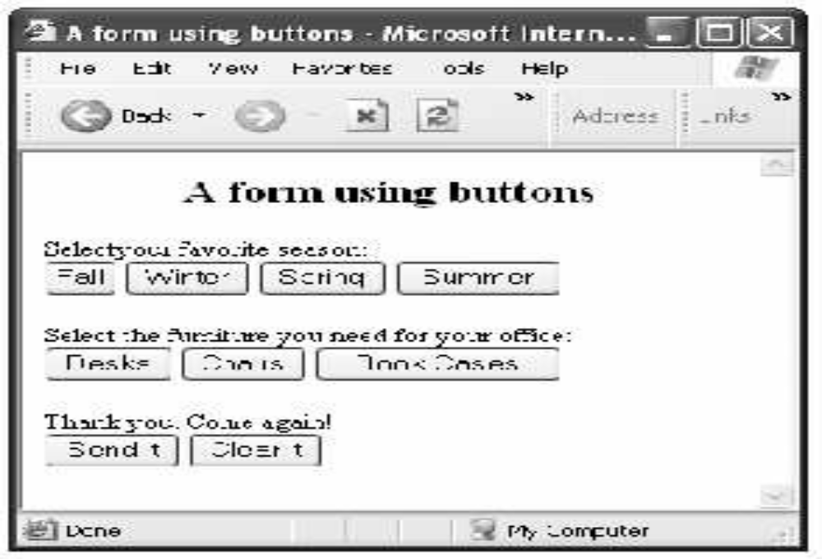
Buttons
<form action="mailto:andrea.f.curley@.dit.ie" method="post">
<div>Select your favourite season:</div>
<input type="button" value="Fall" />
<input type="button" value="Winter" />
<input type="button" value="Spring" />
<input type="button" value="Summer" />
</form>

Slide 26

Text Area
<form action="mailto:andrea.f.curley@dit.ie" method="post">
<textarea rows="4" cols="50">
DT265 is a Level 8 conversion course.
</textarea>
</form>

Slide 27
Value attribute
Value attribute is used differently in different form elements:
  button, submit, reset: it defines the text on the button
  text, password: it defines the initial default value
  checkbox, radio: it defines the value associated with the input

Slide 28
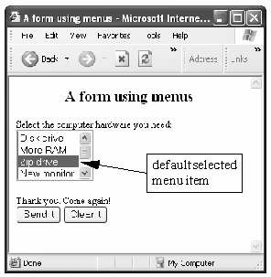
Select List
<form action="mailto:andrea.f.curley@dit.ie" method="post">
<select name="compHardware" size="4">
<option> Disk Drive</option>
<option> More RAM</option>
<option selected> Zip drive</option>
<option> New monitor</option>
</select>
</form>

Slide 29
fieldset & legend tags
The <fieldset> tag is used to group related elements in a form.
The <fieldset> tag draws a box around the related elements.
The <legend> tag defines a caption for the <fieldset> element.
https://www.w3schools.com/tags/tag_legend.asp

Slide 30
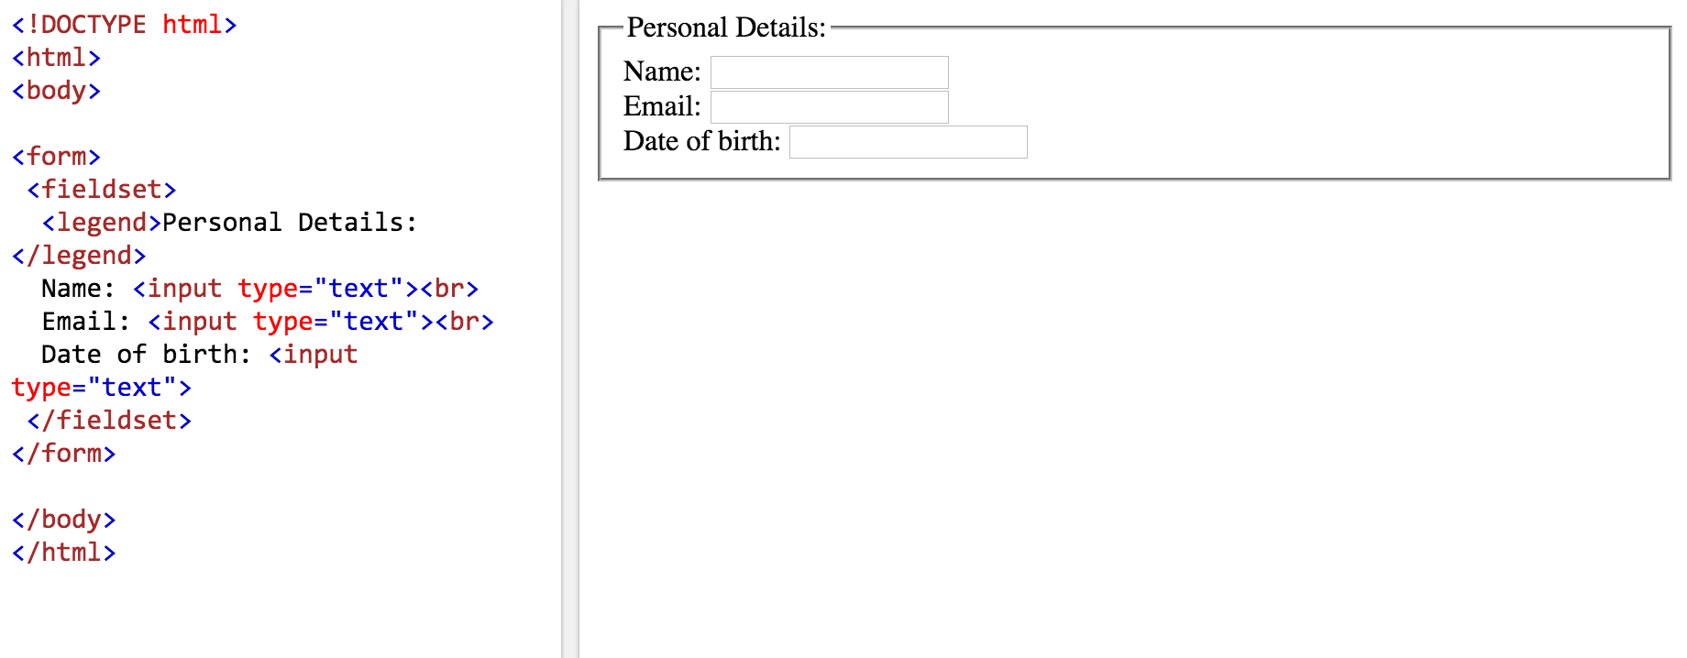
fieldset & legend tags

Slide 31
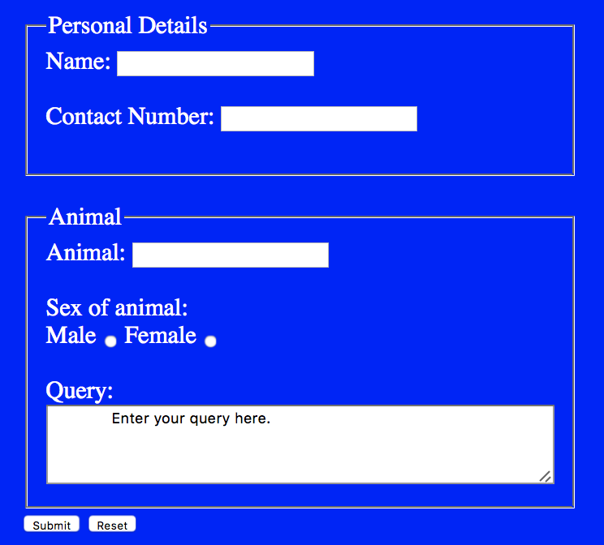
I am going to code this for the Fish Creek Website

Slide 32
HTML5 Attributes

Slide 33
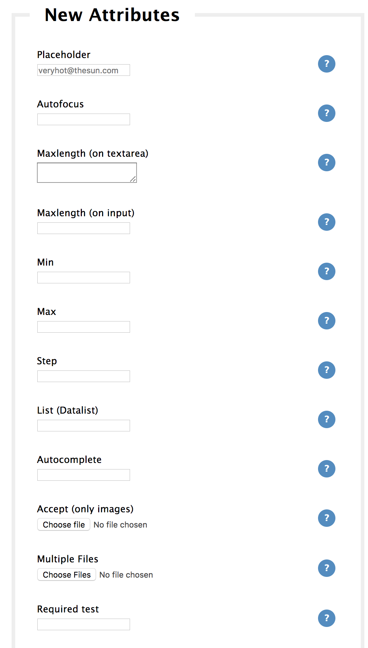
https://tinyurl.com/ycmjnyuc
For associated code samples

Slide 34
<form>…</form>
autocomplete (on/off): browser will autocomplete entire form

Slide 35
<input>…</input>
autocomplete (on/off): browser will autocomplete form element
autofocus: sets focus by putting cursor in element
required: verifies entry before submitting a form
list: contains predefined options (using <datalist>)
min, max: specify minimum and maximum values
placeholder: specifies a short hint

Slide 36
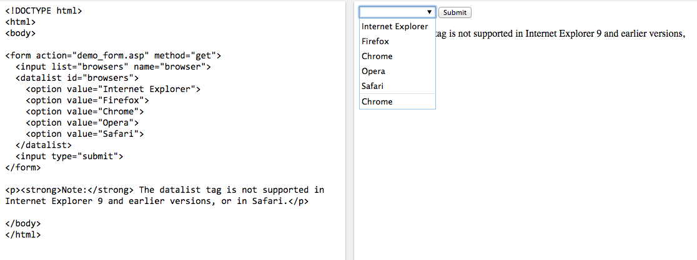
<input>…</input> & <datalist>

Slide 37
<textarea>…</textarea>
autocomplete (on/off): browser will autocomplete form element
autofocus: sets focus by putting cursor in element
required: verifies entry before submitting a form
wrap (hard/soft): configures line breaks within the information shared
maxlength: specifies the maximum length (in characters) of a text area.

Slide 38
